Slide 1
Book1
File created on: 2/27/26 6:00:20 PM GMT+8

Slide 2
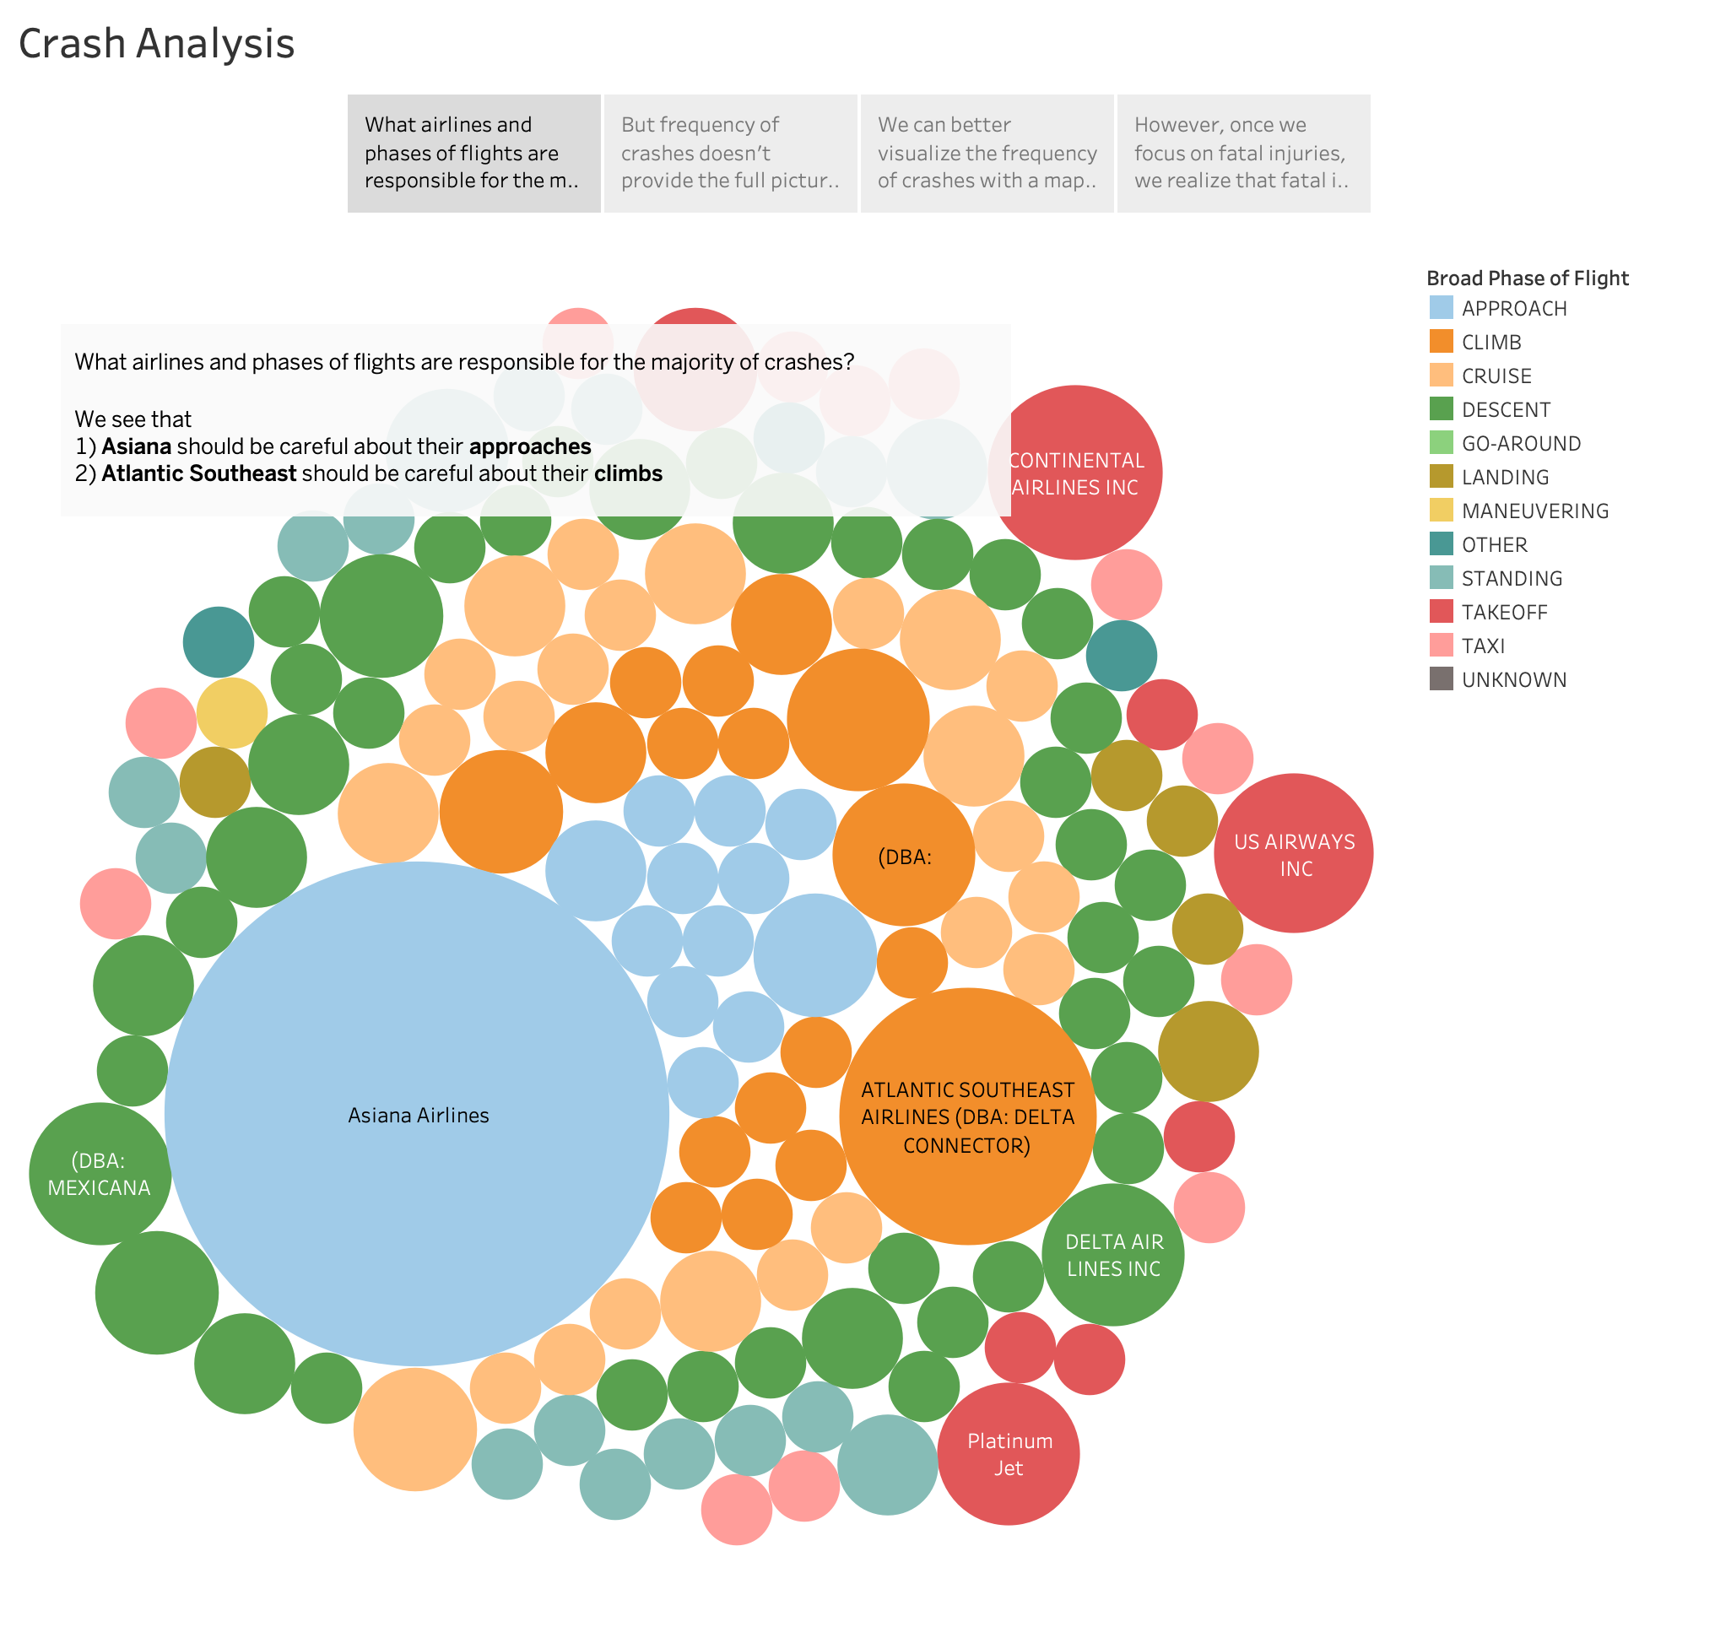

Slide 3
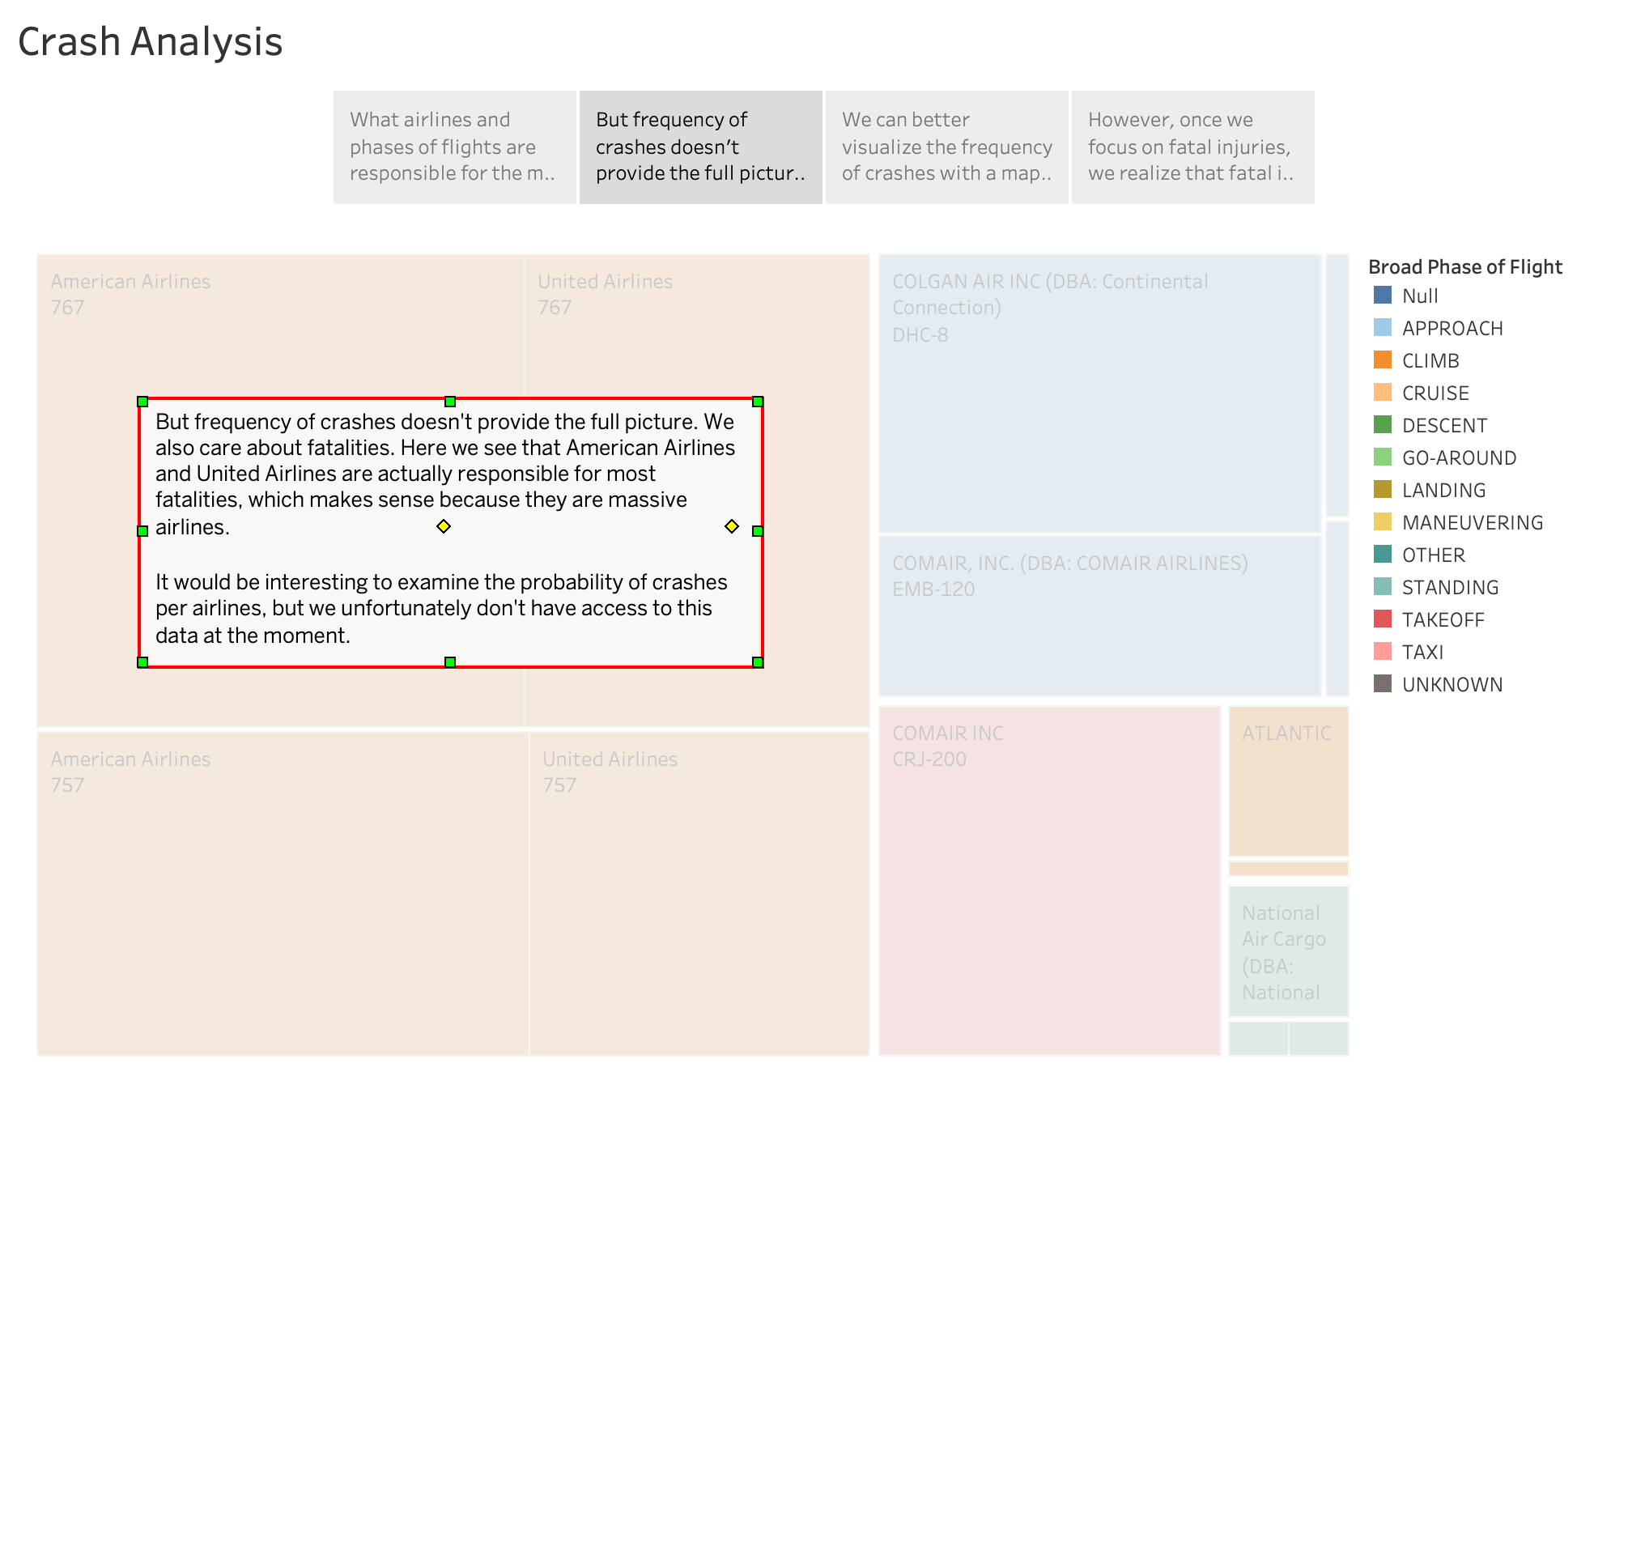

Slide 4
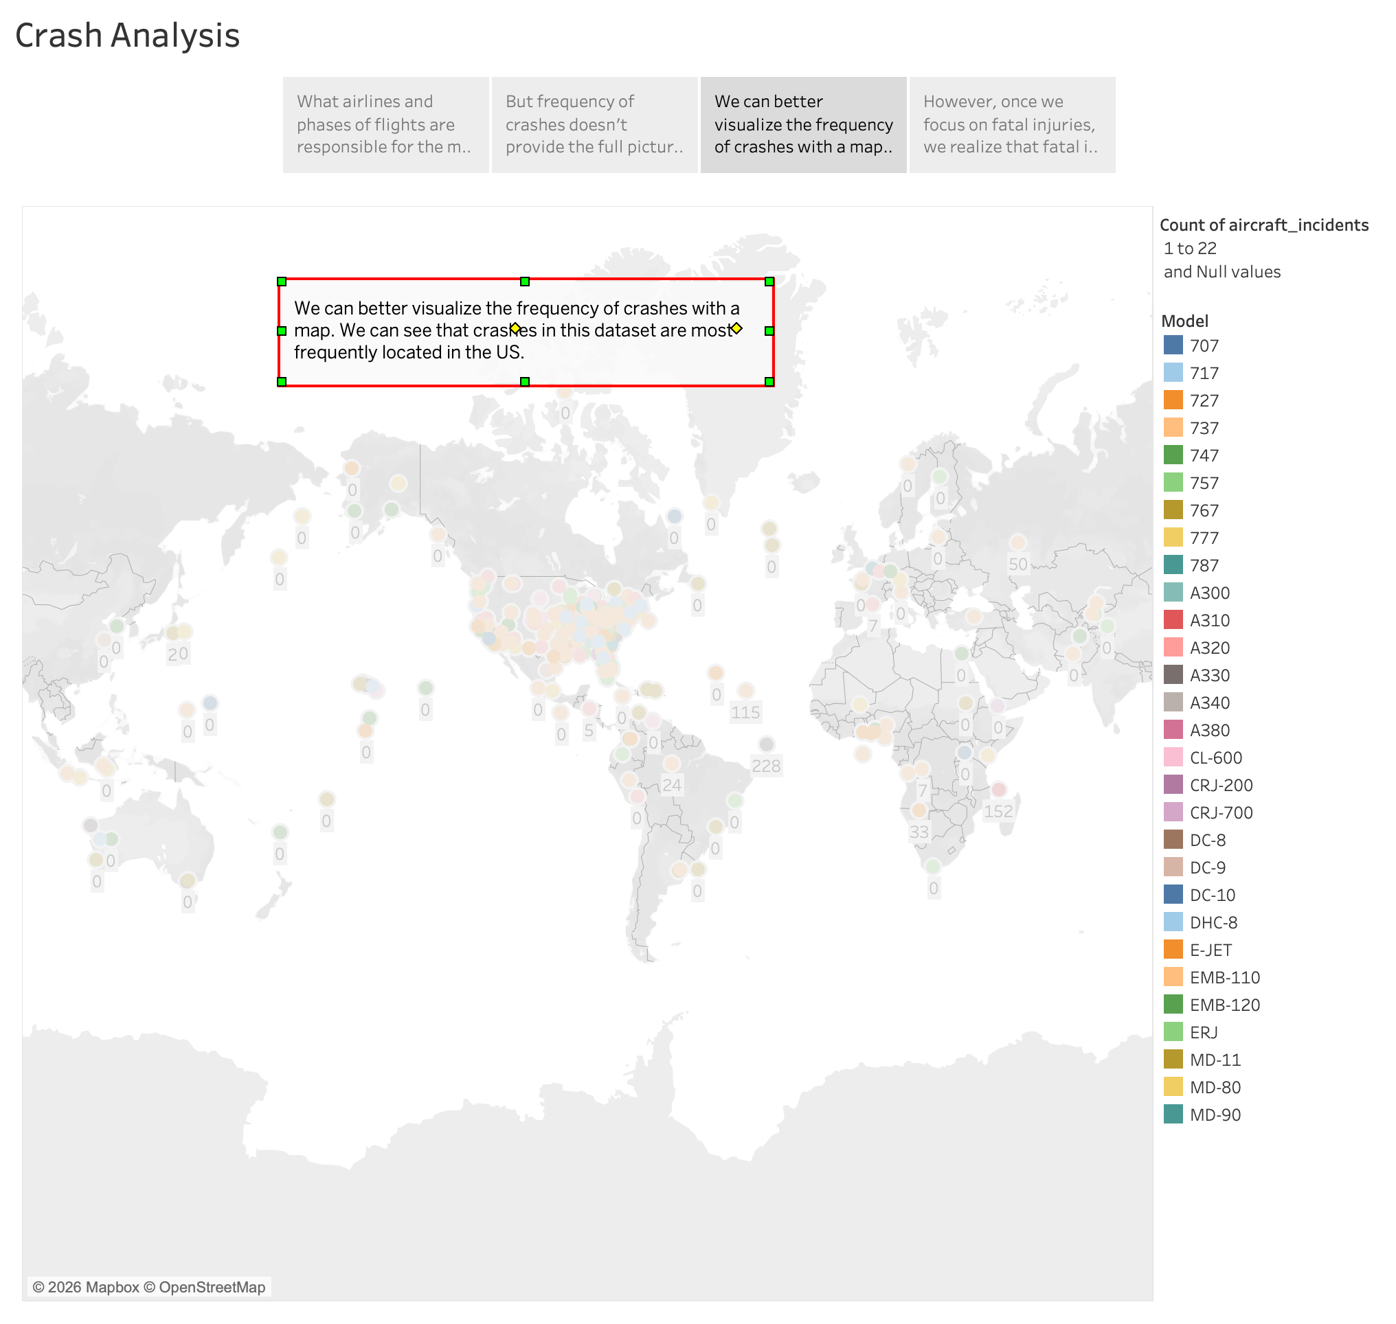

Slide 5
